Slide 1

Chapter 18 Section 8.5
Fault Trees Analysis (FTA)
Don’t get caught out on a limb of your fault tree.

Slide 2
Characteristics
Graphical design technique
Alternative to reliability block diagrams
Broader in scope
Perspective on faults rather than reliability
Model events rather than components
Faults include failures
Focus on a catastrophic event (top event)
Top-down deductive analysis
FTA

Slide 3
The Four Steps to a FTA
(1) Define the system, its boundaries, and the top event,
(2) Construct the fault tree representing symbolically the system and its relevant events,
(3) Perform a qualitative evaluation by identifying those combinations of events which will cause the top event,
(4) Perform a quantitative evaluation by assigning failure probabilities or unavailabilities to the basic events and computing the probability of the top event.
FTA

Slide 4
Fault Tree Symbols
AND gate - a logic gate where an output event occurs only when all
the input events have occurred.
OR gate - a logic gate where an output event occurs if at least one of
the input events have occurred.
Resultant event - a fault event resulting from the logical
combination of other fault events and usually an output to
a logic gate.
Basic event - an elementary event representing a basic fault
or component failure.
Incomplete event - an event that has not been fully developed
because of lack of knowledge or its unimportance.
FTA

Slide 5

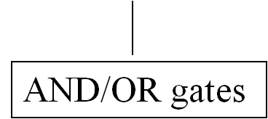
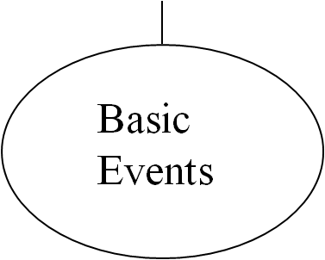
General Structure of a Fault Tree
Top Event
System Failure
FTA

Slide 6
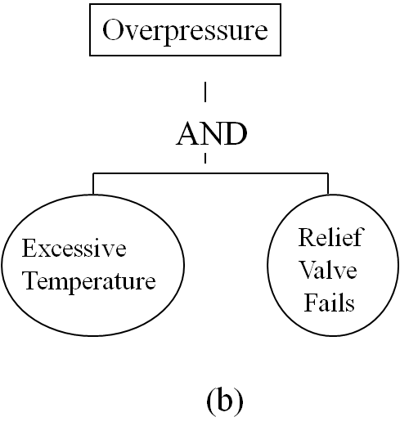
Example of AND / OR Gates
Tank Ruptures
OR
Overpressure
Wall
Fatigue
Failure
(a)
FTA

Slide 7
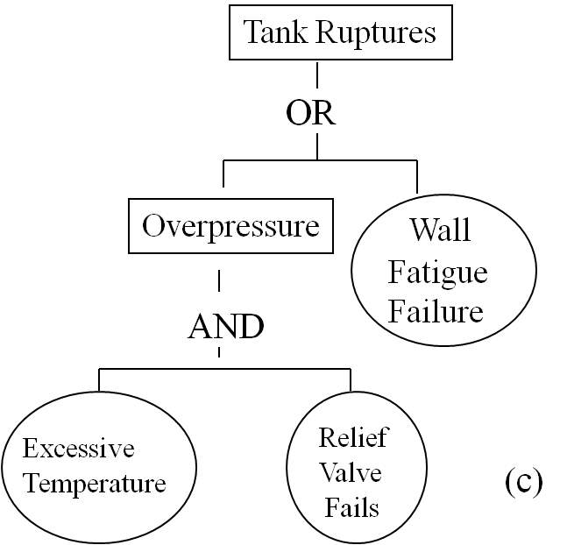
Example of AND / OR Gates
FTA

Slide 8
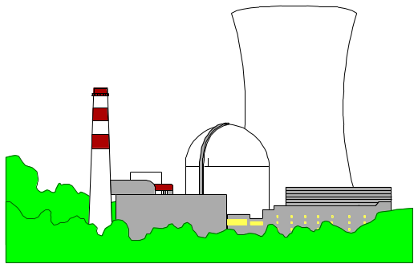
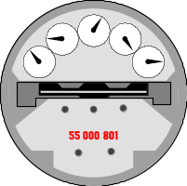

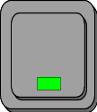


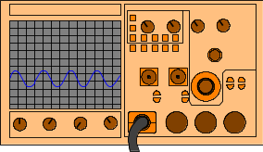
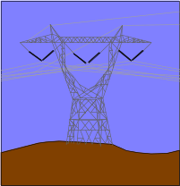
Alarm System Example
meter
switch
alarm
observer
power
source
backup
power
automatic
sensor
FTA

Slide 9
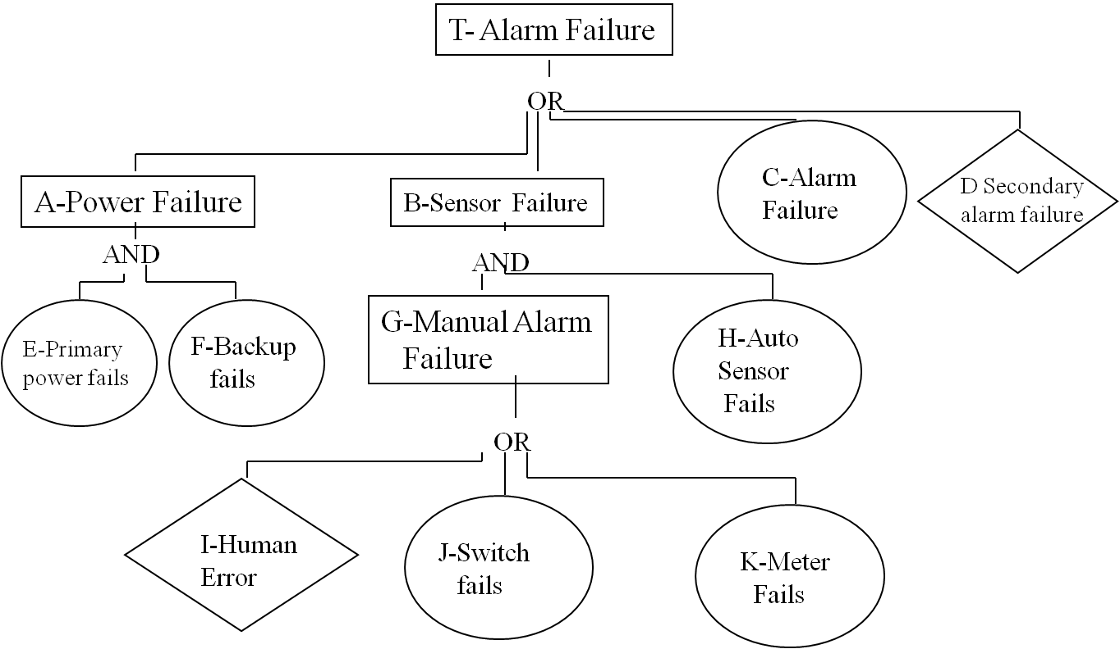
Alarm System Fault Tree
FTA

Slide 10
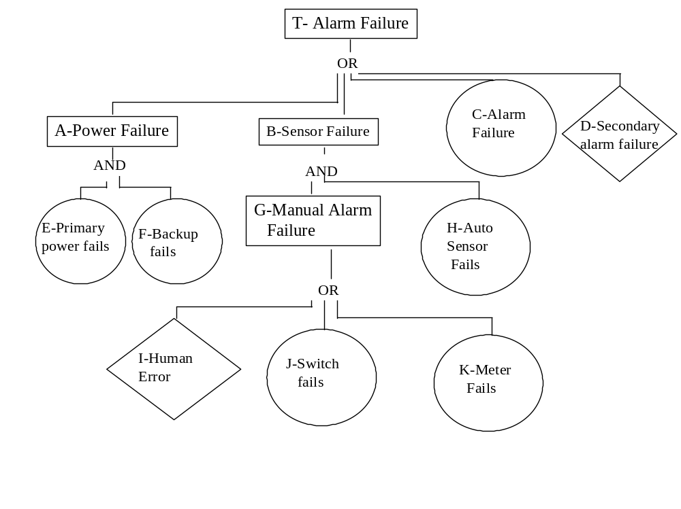
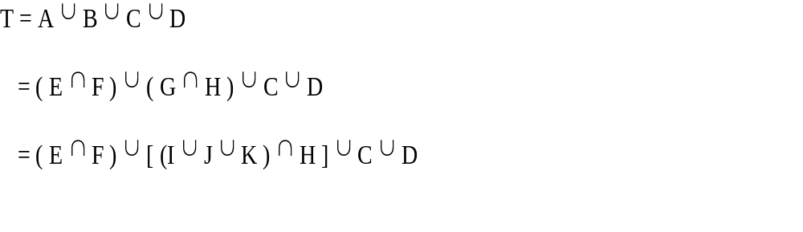
Boolean representation of Top Event
FTA

Slide 11
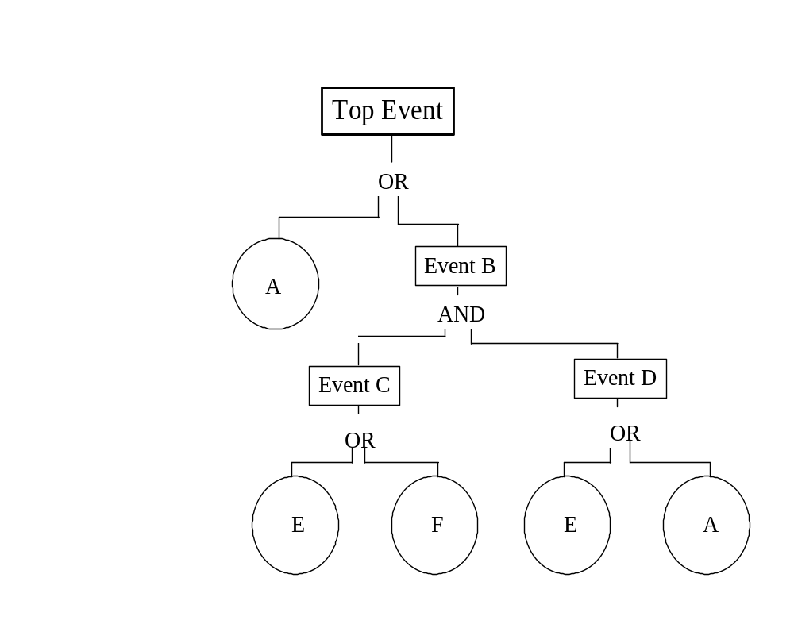
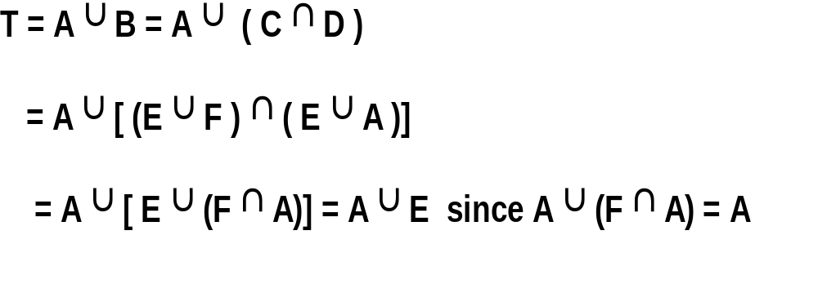
Example
FTA

Slide 12
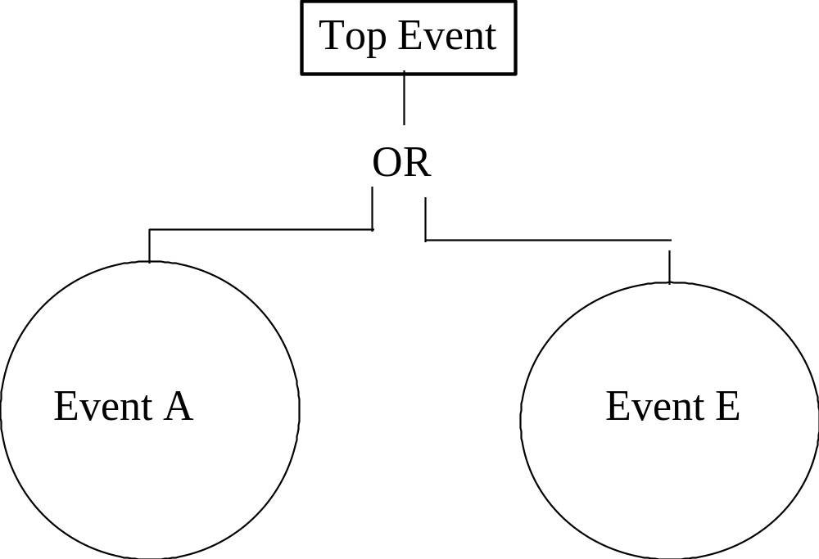
Example Equivalent Fault Tree
T = A U E
FTA

Slide 13

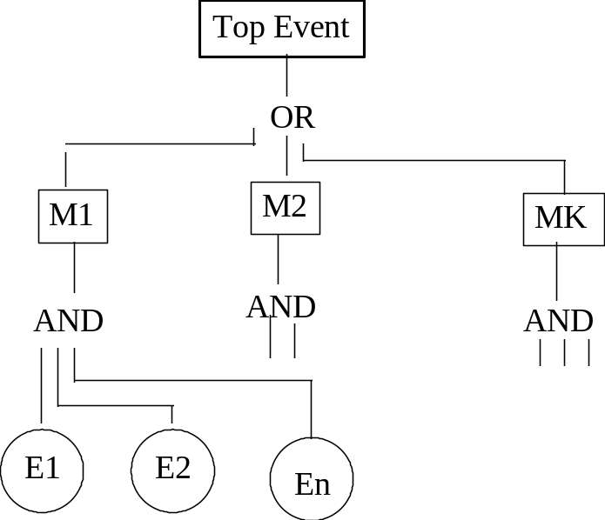
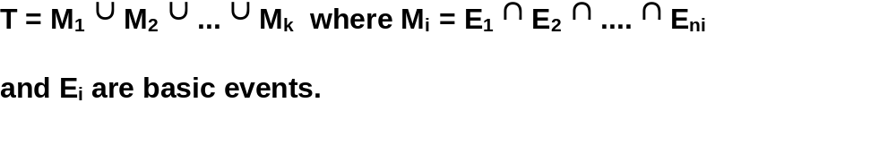
Minimal Cut Sets
A cut set is a collection of basic
events which will cause the top
event. A minimal cut set is one
with no unnecessary events. That
is, all the events within the cut set
must occur to cause the top event
FTA

Slide 14
Example
1
A
B
C
D
2
E,F
G,H
C
D
3
E,F
I,H
J,H
K,H
C
D
FTA

Slide 15
Example Cut Sets
1 2 3 4 5
A A A A A
B C, D E, D E, E E
F, D E, A
F, E
F, A
FTA

Slide 16
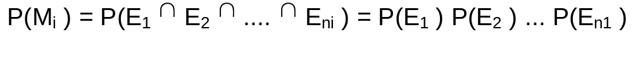
Quantitative Analysis
If cut sets are mutually exclusive:
If P(M) < 10⁻³
P(T) = P( M₁ U M₂ U …U M_{k} )
= P(M₁ ) + P(M₂ ) + ... + P(M_{k} )
If not:
P(T) = P(M₁) +P(M₂) - P(M₁) P(M₂) + etc.
if independent
Then P(M₁) P(M₂) < 10⁻⁶
FTA

Slide 17
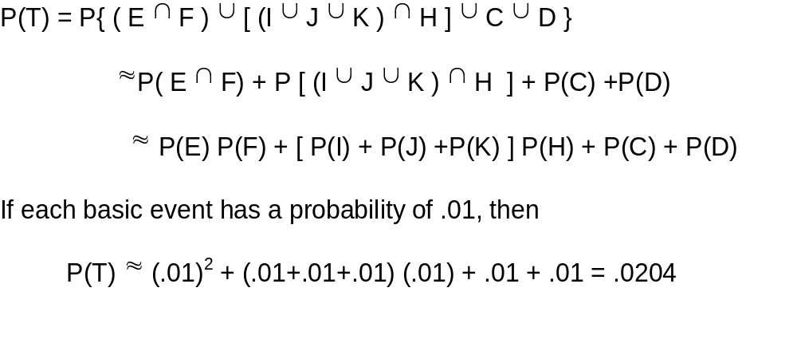
Example
FTA

Slide 18
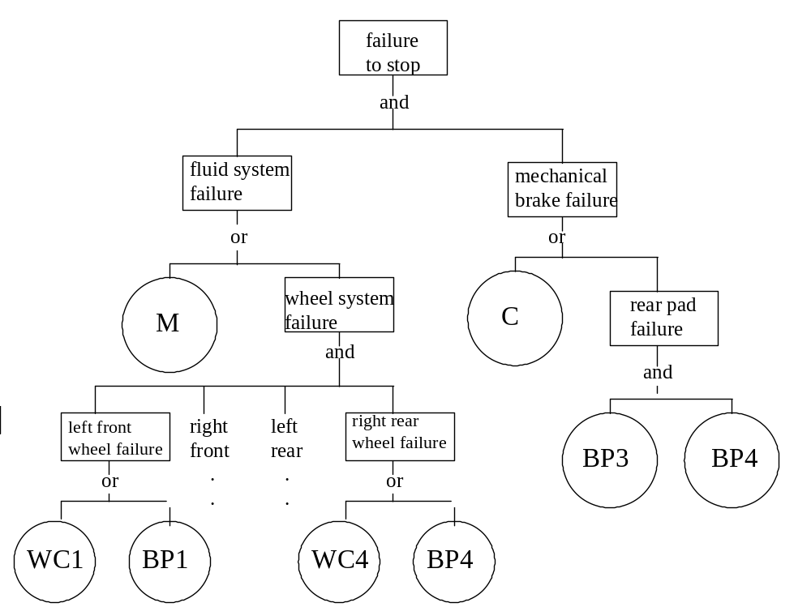
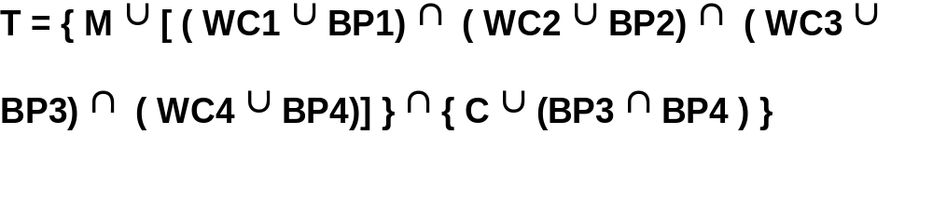
Brake System Revisited
FTA

Slide 19
One Last Example
Top Event
T = A ∪ B ∪ C
= (D ∩ E) ∪ (H ∪ I) ∪ (L ∩ M ∩ N)
= [D ∩ (F ∪ G) ∩ [H ∪ (J ∩ k)]
∪ [L ∩ (P ∪ Q) ∩ N]
= [D ∩ (F ∪ G) ∩ [H ∪ (J ∩ k)]
∪ [L ∩ (R ∪ S ∪ Q) ∩ N]
OR
A
B
C
AND
OR
AND
H
L
M
N
D
E
I
AND
OR
OR
F
G
J
K
P
Q
P(T) ≈ P(D) [P(F) + P(G)] + P(H) + P(J)P(K) + P(L) [ P(R) + P(S) + P(Q)] P(N)
OR
R
S
FTA

Slide 20
The Cut Sets
Top Event
OR
#1
A
B
C
#2
D,E
H
I
L,M,N
#3
D,F
H
J,K
L,P,N
L,Q,N
#4
D,F
D,G
H
J,K
L,R,N
L,S,N
L,Q,N
A
B
C
AND
OR
AND
H
L
M
N
D
E
I
AND
OR
OR
F
G
J
K
P
Q
OR
R
S
FTA

